Slide 2
We’ve got you
Learning how to navigate a new app can be tricky. We’ll show you everything you need to know about using Cisco Webex.
Do you manage projects, people, sales, customers, or technical tickets? Do you need to communicate more effectively with colleagues or students?
This essential guide will show you how easily Webex can fit into your workday by streamlining messaging, meetings, whiteboards, and file sharing all in one app.
Here’s what’s included
Overview of Webex
Who can use Webex
How to quickly install and customize the tool
How to use messaging, searching, meetings
How to seamlessly use a video device with Webex
Useful links and handy tips

Slide 3
Webex works for all types of teams
The growing team
The growing team People come and go. New hires need a smooth joining experience.
Securely exchange personal information with the company and easily access information to quickly be productive.
Meet their team as a group and have one-on-one mentoring sessions.
Enrich the hiring process, from interviews to contract signing and orientation information.
The mobile team
You and your team need the flexibility to get things done while working on-the-go. Being able to access information from multiple locations and devices is key to moving work forward even when you aren’t in the office.
Your team can use Webex through the desktop, mobile, or web apps to get information quickly, seamlessly, and securely.
No matter where you are, your team can collaborate.
The distributed team
Your team is spread around the world, which allows you to attract and retain talent anywhere.
Use spaces and teams to access and share the most valuable knowledge from and with people all over the company.
Answer questions quickly from your mobile device, at any time of day.
Make virtual leaders more present and involved while avoiding information overload.

Slide 4
Webex matches all teams’ working styles
The creative team
You need to keep the creativity at a high level and deliver promptly, regardless if the stakeholders are internal, external, local, or international.
Use pictures and drawings, not just words, to describe their idea and provide feedback.
Easily have impromptu or scheduled video calls with any internal or external stakeholder to review documents live and see facial reactions
The project team
Task-oriented and deadline-driven. Great team coordination is necessary as well as regular sync-up to measure progress and discuss tasks.
Clear audio and video meetings for sharing content and making decisions.
Collaborate with external vendors, partners, and suppliers.
Always be available for your stakeholders from your mobile device.

Slide 5
Getting started

Slide 6
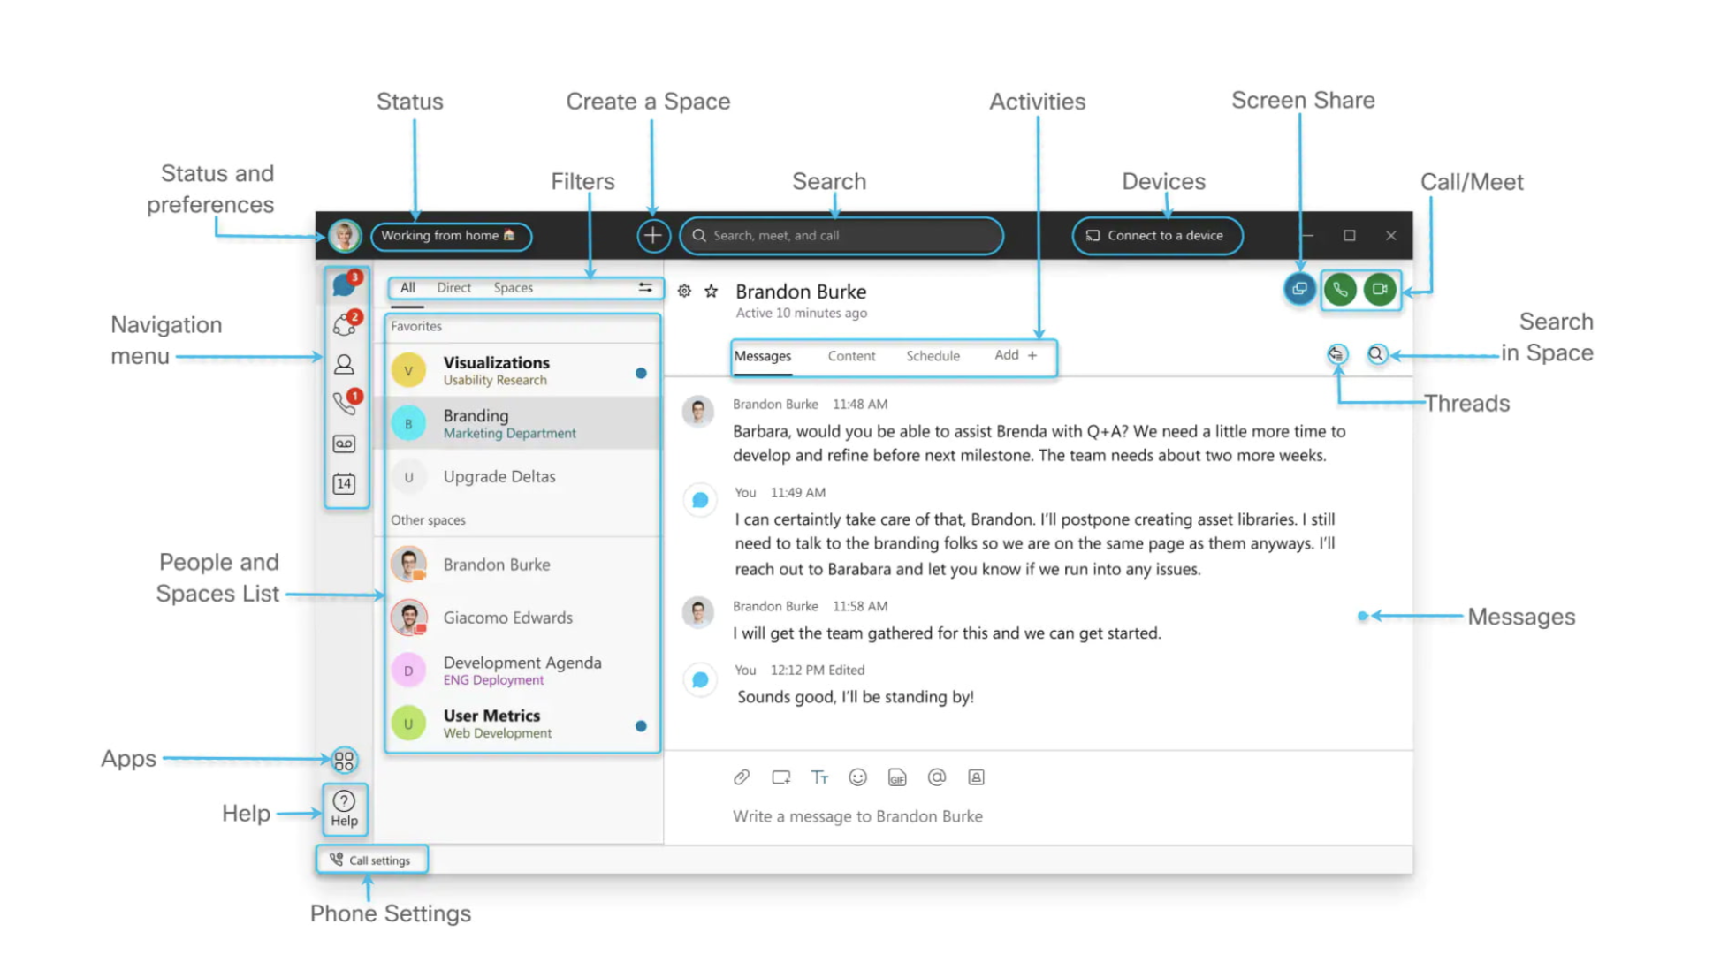
Get to know Webex

Slide 7
Customize the app
Add a profile picture
A clear picture of you makes it easier for others to reach out to you.
Step 1
Click on your initials on the top left corner.
Step 2
Click on your initials in the window that opens.
Step 3
Select a picture.
Step 4
Change the email address to your name, just under the profile picture

Slide 8
To manage notifications, your camera, and audio settings, click on your profile picture and select Settings.
Notifications
Set your notifications to stay up-to-date.
Step 1
Click on Notifications.
Step 2
Select the notifications for your spaces, scheduled meetings, and calls.
Step 3
Select your notification sounds.
Step 4
Click Save.
Check your camera
Select which camera you want to use in calls and meetings if you have more than one connected to your computer (in-built, external).
Step 1
Click Video.
Step 2
Select your webcam from the drop-down list.
Step 3
Click Save.
Test your audio
Make sure it’s working properly and that you hear the audio notifications at all times.
Step 1
Click Audio.
Step 2
Select which device will be used for the microphone, speaker and ringer.
Step 3
Click Save.

Slide 9
Create teams and spaces to manage all your communication and collaboration needs
Team
A team is a group of people who are connecting for a longer-term community, a larger project or business objective.
Each team has a space called General that everyone belongs to.
You can add any number of additional spaces to the team to divide up projects or priorities within the team.
Space
A space is a group of people who have been invited to work together.
Spaces typically have names that describe what they’re for or are named after the people in them if they’re one- on-one.
A space can either be standalone or associated with a team. They can grow or shrink as needed.

Slide 10
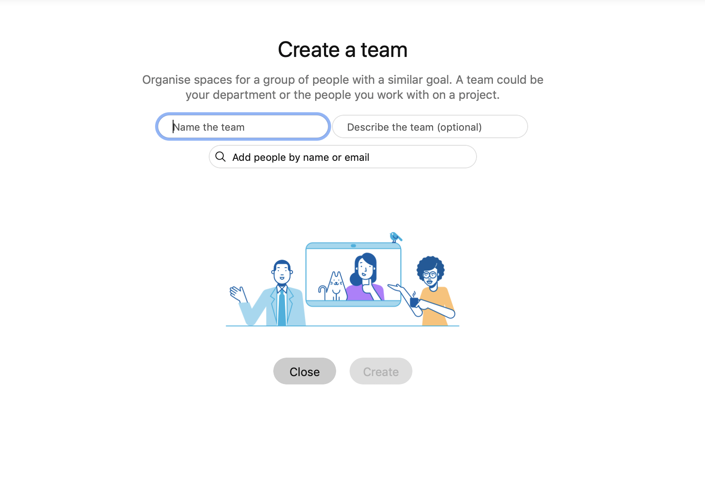
Create a team
In Cisco Webex, teams help you keep everything organized by categorizing multiple Spaces under a common theme
Step 1
Go to Teams.
Step 2
Choose the Plus icon, name the team, and click Create.
Step 3
Use the search bar to add team members. Enter a name or email address and pick from the results list. People get added to the General space automatically, but then can join any team spaces on their own.
Step 4
Click Create. To create more spaces for the team, click Create a space and add the space name.

Slide 11
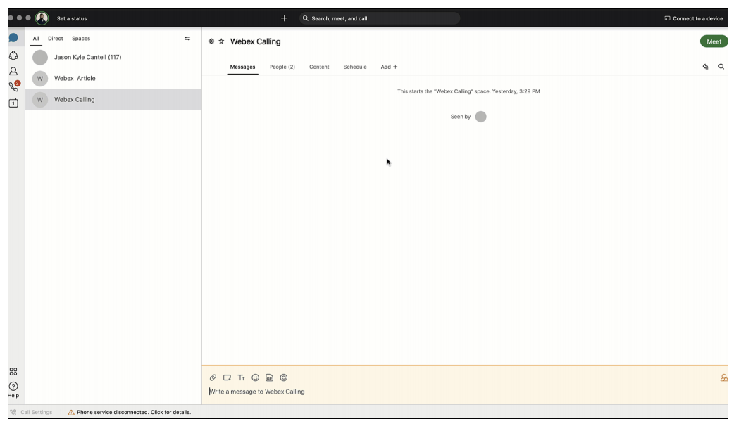
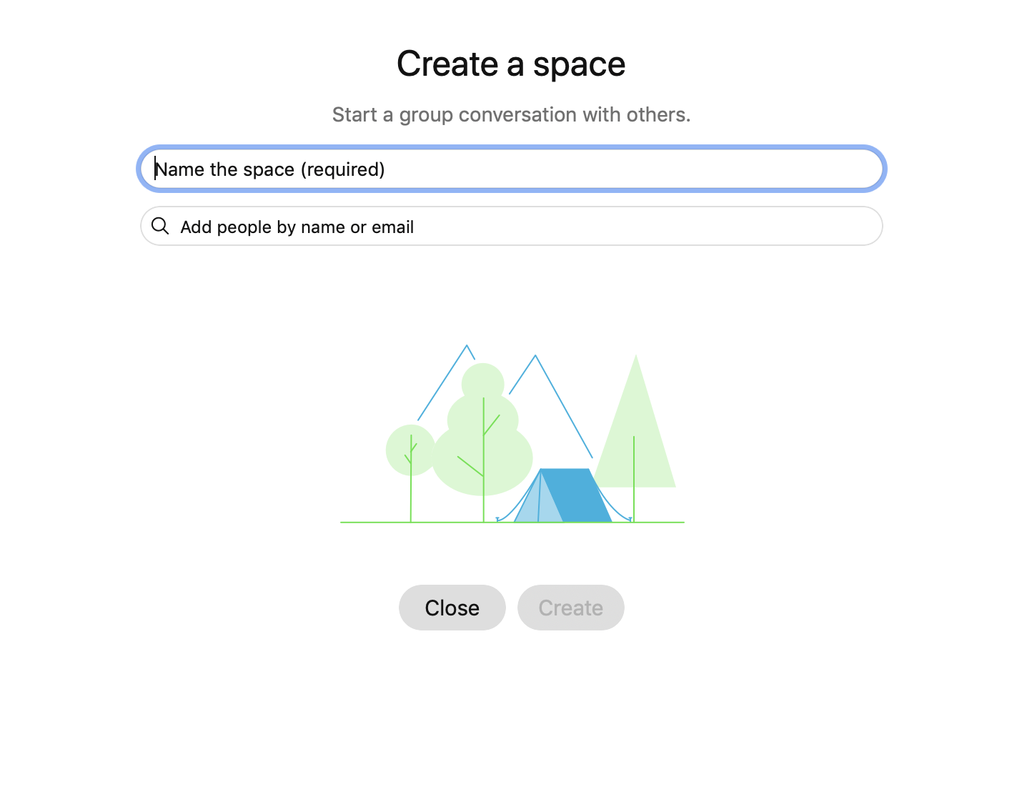
Create a space
In Cisco Webex, you can interact 1-1 or you can collaborate with a group of people using spaces.
Step 1
Click the + sign next to the Search field.
Step 2
Click Create a space.
Step 3
Type a name for your space.
Step 4
Enter the names of people you want to invite.
Step 5
Click Create.
Tip:
Create a 1:1 space with a co-worker or client to have conversations, meetings, and share files anytime.
Create 1: many spaces to share files, chat and meet with your teams to keep project velocity at top speed.

Slide 12
Making things happen with messaging and search

Slide 13
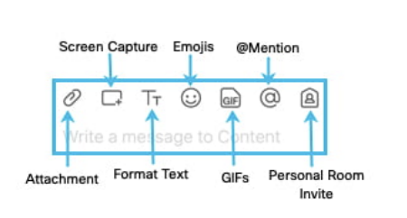
Powerful messaging
@mention
To grab someone’s attention @mention their name. They will see @ against the Space, showing that their name has been tagged.
Send someone a message
You can easily contact internal or external people using the chat panel for 1:1 interactions or group communications in spaces.
Type the name of the person or space in the Search field. Click the person or space name. Type your message and press the enter key.
Give your message some personality
You can customize your message by formatting the text, inserting emojis and gifs, or adding attachments and screen captures.
Edit messages
Made a typo? Not a problem, simply hover over your message and click Edit message. Then, make your changes and click update. After you update the message, you'll see (Edited) next to it in the space
React to messages
Want to add a quick reaction to a message? Hover over the message you’d like to react to and click the Add reaction icon.
Answer a specific message in a thread
Slide your mouse above the message and use the arrow option.

Slide 14
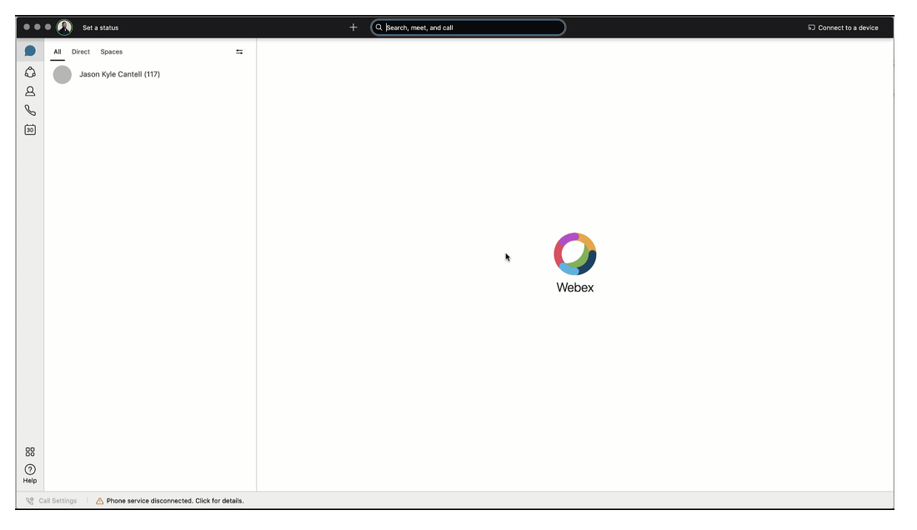
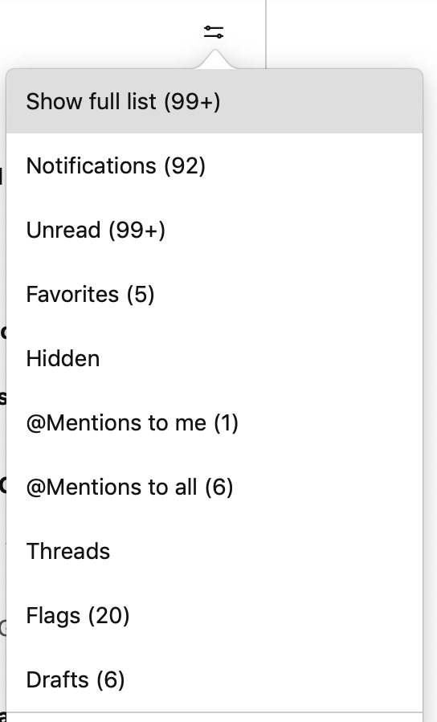
Sort messages
Notifications: Shows a list of all spaces where you have notifications selected and something new happened.
Unread: Shows all unread messages.
Favorites: Shows a list of all spaces you marked as favorites.
Hidden: Shows all of your hidden spaces. Hidden spaces no longer show in your spaces list.
@mentions to me: Shows a list of all messages you have personally been @mentioned in.
@mentions to all: Shows a list of all messages where everyone was @mentioned in spaces you are a member of.
Threads: Shows a list of threads within chats and spaces.
Flags: Shows a list of all messages you’ve flagged.
Drafts: Shows a list of your drafted messages.
To help zoom in on priority items and avoid information overload, simply click the Filter icon and select:

Slide 15
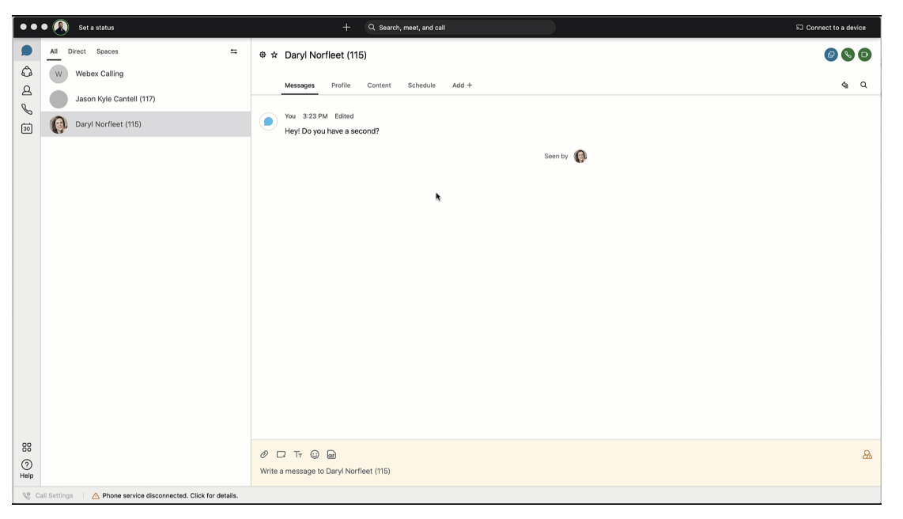
Search messages, files, and people
Thanks to the advanced search feature, you can easily rediscover people, spaces, messages, and files.
Search for people or spaces
Start typing the person or space name into the Search field.
Search for content in a chat or space
If you are looking for a chat message or file, click the Search icon within the chat or space. Then enter the keywords or document name in the search field.
Tip:
If needed, refine your search by first typing one of the following:
In: Enter the name of the space and choose a space from the list.
From: Enter the person's name and select the person from the list.
With: Enter the person's name and select the person from the list. The results include spaces you are in with this person.

Slide 16
Getting work done with calling and scheduling

Slide 17
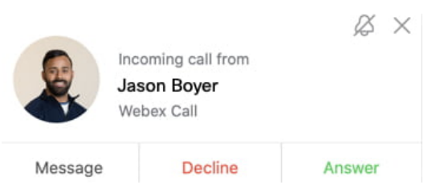
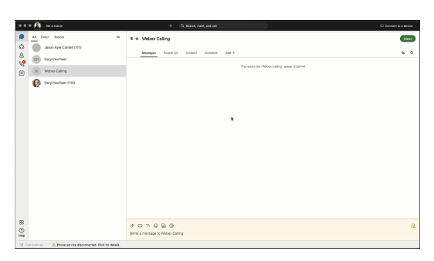
Starting and answering calls
You can start video and audio calls with individuals from 1:1 spaces.
Step 1
Click the Search field.
Step 2
Start typing the name of the person or space you want to call.
Step 3
Click the name of the person or space in the results list.
Step 4
Click the Audio Call or Video Call icon at the top right of the space.
Start a call
There are different ways to call in Webex. One easy way is to:
Answer a Call
When you receive a call, you’ll see a notification allowing you to:
Answer: To take the call.
Decline: If you can’t answer now.
Message: If you want to answer with a chat message instead.

Slide 18
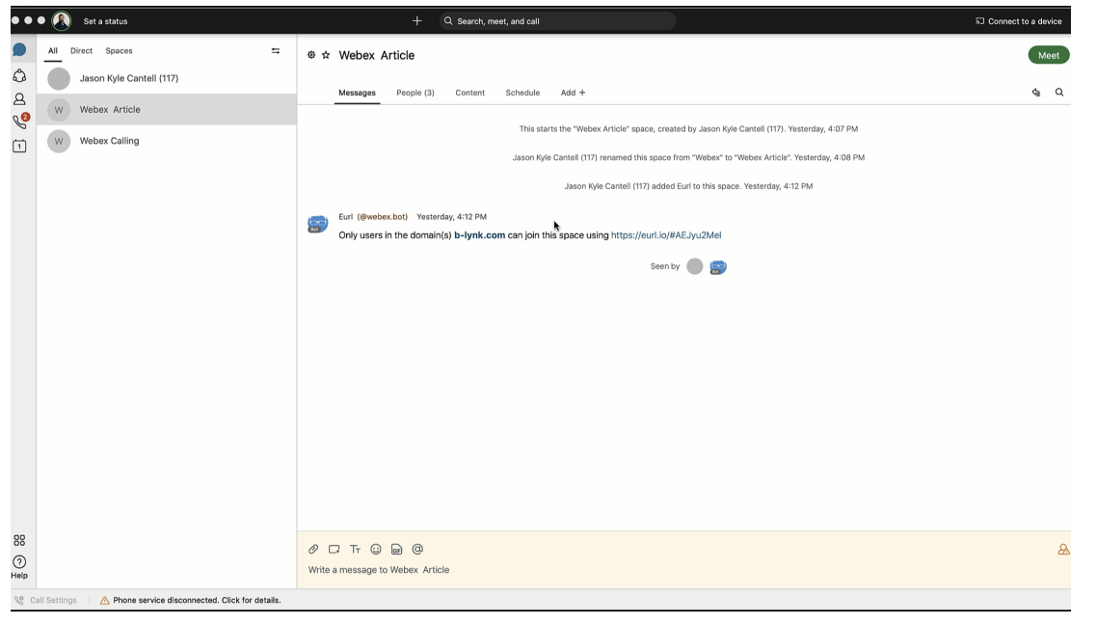
Starting meetings in a space
You can start a meeting directly from a space. Need to escalate from messaging to a meeting? You can also initiate an ad-hoc meeting just by clicking Meet in your space.
All team members that have “Smart Notifications” set up will get a ping that their team is meeting!
And the green meet button will appear next to the space.
They only need to click to join in!
Tip: Any member of the space can start the meeting.

Slide 19
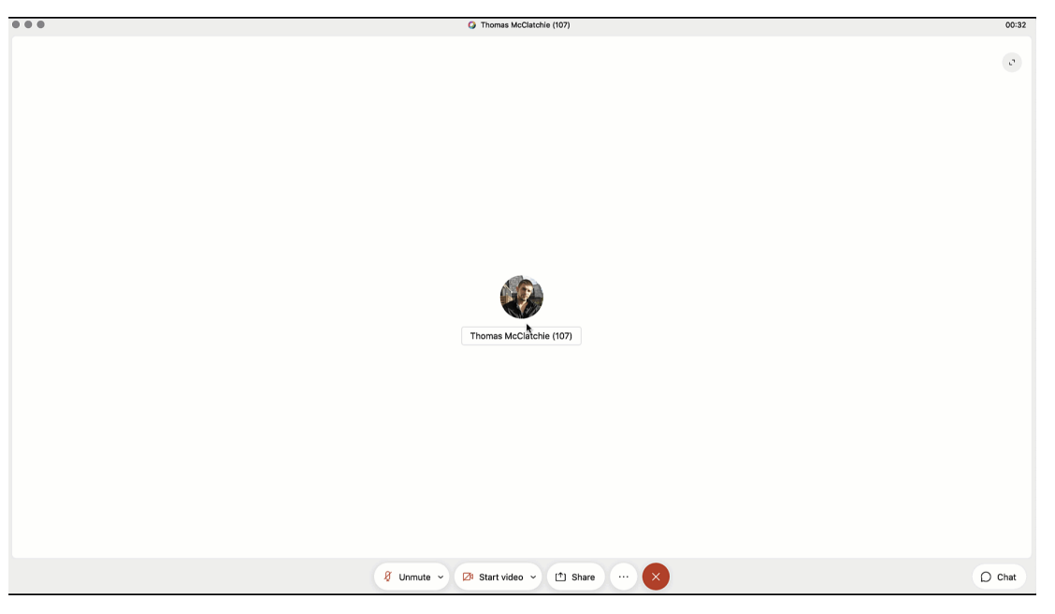
Invite someone from within a call
When a call is running in a space, you may wish to invite someone as a guest but not add them to the space. To do this when on the call:
Step 1
Click the "..." icon in the meeting window.
Step 2
Click Invite guests to meeting.
Step 3
Type the name of the person you want to invite or their email address.

Slide 20
Co-create with whiteboarding and screen sharing
Whiteboards are powerful and simple tools to convey visual ideas and brainstorm on projects. Within Webex you can share whiteboards both during and outside a meeting.
Within a meeting
Step 1
Click the "..." icon in the meeting window
Step 2
Click New whiteboard.
Step 3
Use the annotation tool to draw on the whiteboard. You can also continue an existing whiteboard previously shared in the space.
Outside a meeting
Step 1
Click the space where you want to share the whiteboard.
Step 2
Click the Content tab.
Step 3
Click Whiteboards.
Step 4
Click New whiteboard. Alternatively, you could reopen a whiteboard already shared in that space.
Step 5
Use the annotation tools to draw on the whiteboard.
Step 6
Click the Share icon.
Step 7
Click Post snapshot for your whiteboard to appear in the chat thread.

Slide 21
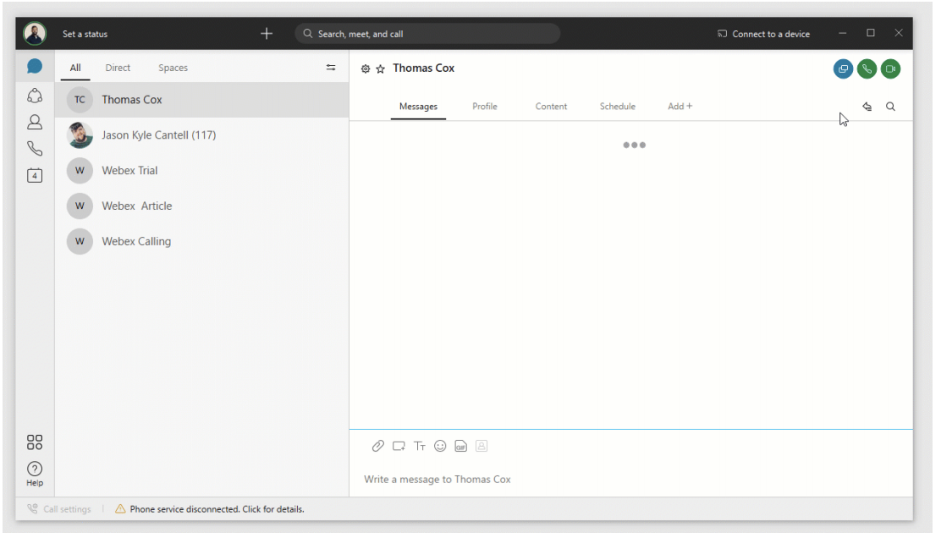
Share screen
In Webex you can share your screen with others, including streaming videos. Share your screen during a meeting or even in 1:1 spaces outside, of a call.
Step 1
Click the Share screen icon
Step 2
If you are planning to share a video, check Share computer audio and Optimize for video on top of the screen.
Step 3
Select the screen you want to show
Step 4
To stop, click Stop in the orange bar at the top

Slide 22
Be a Webex master Tips and Tricks

Slide 23
Spaces tips and tricks
Add an external participant to a space
You are not limited to communicating with only your organization. Invite external contacts like vendors or customers to collaborate with you in spaces using their email. You can keep track of what spaces have external contacts by the icon in the lower right corner.
Add integrations to your space
You can see directly in the Webex space if someone added something new in your CRM, or updated specific documents in Dropbox. To get all the information you need in one place, jump to the Cisco Webex App Hub to check the available integrations. Can’t find what you need? Jump to developer.webex.com to build your own.
Forward messages
Sometimes you see a message in one space and want to share it with people in another. You might be chatting directly with someone, but something comes up in that conversation that you'd like to discuss with others.
Add a space to your favorites list
You can be more engaged in some spaces than in others. To keep a closer eye on those spaces that truly matter, you can add them to your favorites list by clicking the star in front of the space name.

Slide 24
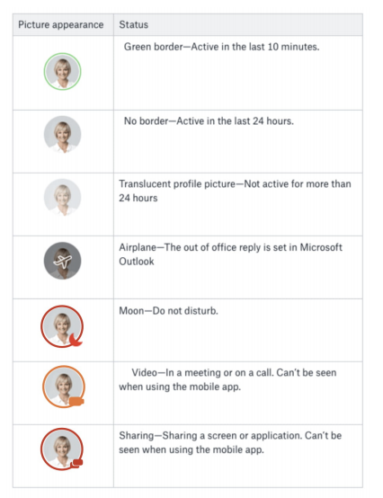
Check people status
Knowing if people are available is important when you need to communicate with them. With Webex, just use the Search field to find someone and hover over their picture to get more information.
Turn on announcement mode
What if you need to dispatch information to an audience without a long thread of reactions? Switch on Announcement mode so only the moderators can post in the space.
Step 1
Click the Space Information icon in front of the space name.
Step 2
Click Moderate space.
Step 3
Click Moderate.
Step 4
Click the Space Information icon in front of the space name.
Step 5
Click Turn on announcement mode.
Step 6
Click OK.

Slide 25
Bots
Cisco Webex makes it possible to bring content into Teams and Spaces from any other application. Access business information and alerts from other systems. Avoid switching in and out of different apps to get information. It’s also possible to create bots to automate repetitive, high-volume business processes, that no one enjoys doing.
Bots
A bot is a simple way for users to use natural language to request automated tasks to be completed on another platform.
In Webex, a bot is a member of a Space just like any other real person. The possibilities of bots are endless. They can be as simple as getting weather updates where you live, or as complex as booking a meeting room or a flight.
Jump to Cisco Webex App Hub to browse integrations available for popular business applications and also some that third-party developers have built that could be useful to your organization.

